Slide 1

OPENREFINE A DATA CLEANING TOOL

Slide 2
DATA CLEANING
Definition
Data cleansing or data cleaning is the process of detecting and correcting (or removing) corrupt or inaccurate records from a record set, table, or database and refers to identifying incomplete, incorrect, inaccurate or irrelevant parts of the data and then replacing, modifying, or deleting the dirty or coarse data.
It is the process of ensuring that your data is correct, consistent and useable by identifying any errors or corruptions in the data, correcting or deleting them, or manually processing them as needed to prevent the error from happening again.
Why data cleansing?
Data quality is of central importance to enterprises that rely on data for maintaining their operations.

Slide 3
DATA CLEANING
How to clean?
Develop and implement data constraints comprising the following:
Design data constraints
Data type constraints
Range constraints
Mandatory constraints
Unique constraints
List of values constraints
Regular expression patterns constraint
Cross validation of multiple fields constraints

Slide 4
DATA CLEANING
Design data constraints
1) Data type constraints such as Age field must be numeric, name field to be alphabetic etc. and willingness to subscribe to a new journal must be categorical with several levels
2) Range constraints such as the field date of leaving an organization must be later than date of joining; blood sugar level of a nondiabetic patient must be in the range 60 to 120 mg/dL or for others the range could be from 40 to 2500 mg/dL (Guinness World record)
3) Mandatory constraints such as blood pressure of a living patient cannot be zero or email address of the customer cannot be blank
4) Unique constraint implying a single field or combination of fields must be unique across the dataset. For example, an Indian citizen can have only one Aadhaar card number.

Slide 5
DATA CLEANING
Design data constraints - continued
5) List of values constraint such as the field gender can have one of three values Male, Female and Neutral; Postal code in India must appear in the Pin code directory released by India Post
6) Regular expression patterns constraint such an email address field must have the pattern local-part@domain as per RFC 3696 standard. For example info@abc.com is a valid email address and info#abc.com is not valid.
7) Cross validation of multiple fields.
For example, in laboratory medicine, the sum of the components of the differential white blood cell count must be equal to 100 (since they are all percentages).
In addition to the above, we need to fix structural errors like Country field can have entries like USA, US, United States of America, America all implying USA.

Slide 6
DATA CLEANING
Data cleansing tools
1) Openrefine
2) Trifacta Wrangler
3) Drake
4) TIBCO Clarity
5) Wincore
6) Data Cleaner
7) Data Ladder
8) Cloudingo
9) Reifier
10) IBM Infosphere Quality Stage

Slide 7
DATA CLEANING
Interactive Data Transformation Tools (IDT) vs Excel
You can use Microsoft Excel to sort your data based on numerical, alphabetical and custom-developed filters, which allows you to detect errors more easily.
Setting up these filters in a spreadsheet can be cumbersome, as they are a secondary functionality.
On a more general level, we could say that spreadsheets are designed to work on individual rows and cells
IDTs operate on large ranges of data at once.
These ‘spreadsheets on steroids’ offer an integrated and user-friendly interface through which end users can detect and correct errors.

Slide 8
DATA CLEANING
Openrefine tool
Openrefine, previously known as GoogleRefine, is a powerful, open source software which visualizes and manipulates large quantities of data all at once.
Openrefine looks like a spreadsheet, but operates like a database, allowing for increased discovery capabilities beyond programs like Microsoft Excel.
Openrefine is a Java program that runs on your machine (not in the cloud): it is a desktop application that uses your web browser as a graphical interface. No internet connection is needed, and none of the data or commands you enter in Openrefine are sent to a remote server.

Slide 9
DATA CLEANING
Openrefine tool
Openrefine does not modify your original dataset. All actions are easily reversed in Openrefine and you can capture all the actions applied to your data and share this documentation with your publication as supplemental material.
Openrefine saves as you go. You can return to the project at any time to pick up where you left off or export your data to a new file.
Openrefine can be used to standardize and clean data across your file.

Slide 10
DATA CLEANING
Basic functions
Openrefine can be used to explore, clean, and link data on a large scale.
Functions include:
Data Normalization
Column Reorganization
Faceting and Clustering
Tracking Operations
Exporting Data

Slide 11
DATA CLEANING
Reference
https://en.m.wikipedia.org/wiki/Data_cleansing
https://www.geotab.com/blog/data-cleaning/
https://sunscrapers.com/blog/why-is-clean-data-so-important-for-analytics-and-business-intelligence/
https://www.guinnessworldrecords.com/world-records/highest-blood-sugar-level/?fb_comment_id=811257658947726_974655159274641#:~:text=Michael%20Patrick%20Buonocore%20(USA)%20(,-120%20mg%2Fdl).
https://datacarpentry.org/OpenRefine-ecology-lesson/00-getting-started/
https://programminghistorian.org/en/lessons/cleaning-data-with-openrefine
https://en.m.wikipedia.org/wiki/OpenRefine
https://guides.library.illinois.edu/openrefine/about#:~:text=OpenRefine%2C%20previously%20known%20as%20GoogleRefine,beyond%20programs%20like%20Microsoft%20Excel.

Slide 12
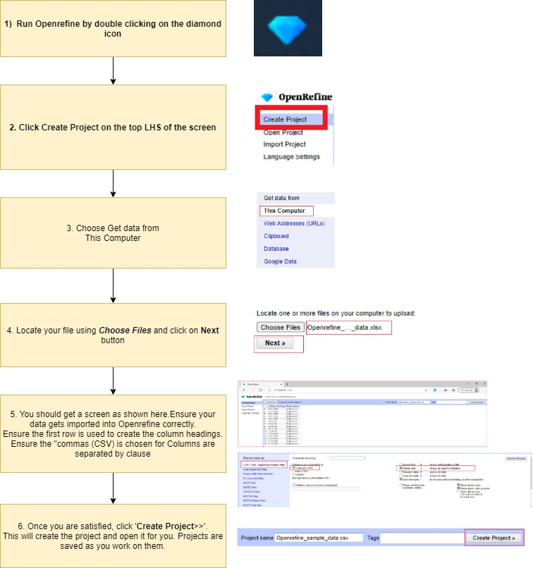
DATA CLEANING

Slide 13
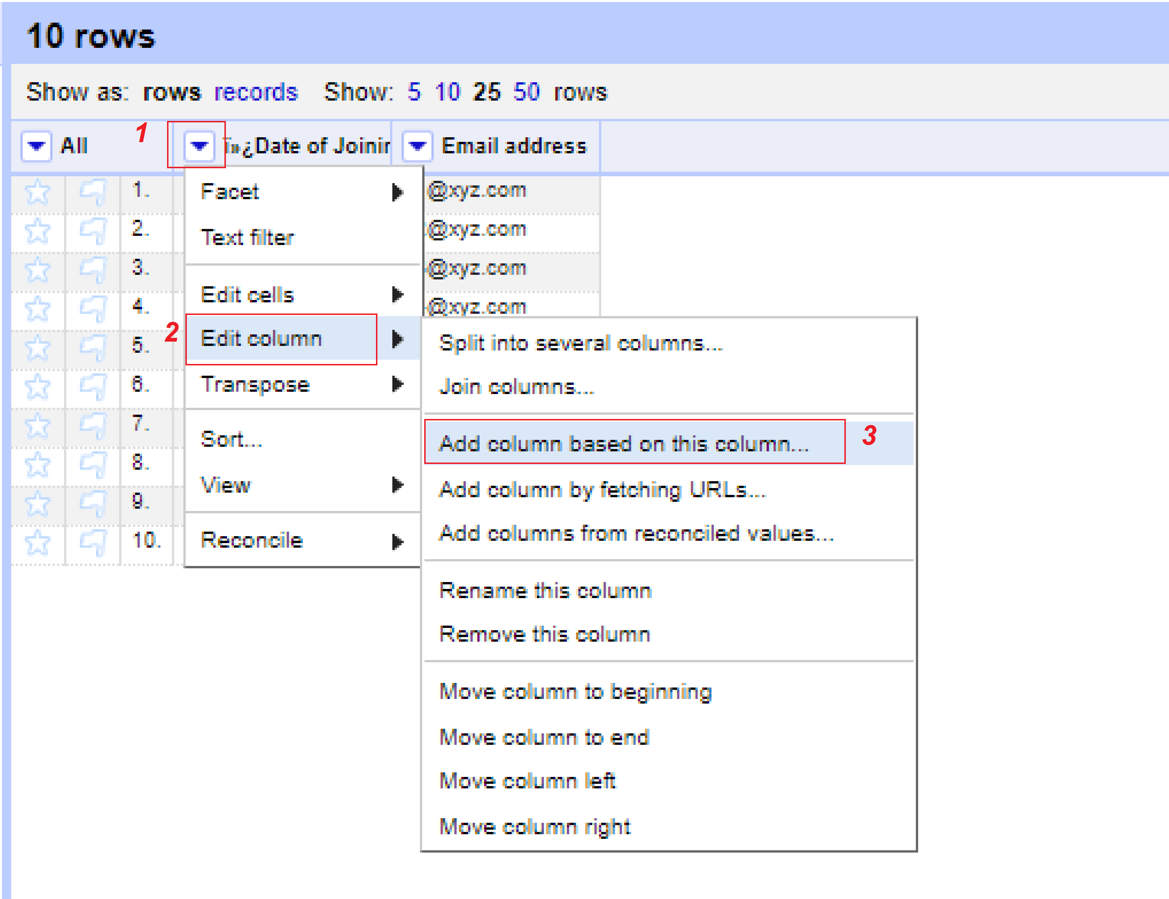
DATA CLEANING
Create a new column 'Edited_DOJ'
Create a new column 'Edited_DOJ' as follows:
1. Click on the LOV button near the column Date of Joining
2. Click on the Edit column tab
3. Click on the Add column based on this column

Slide 14
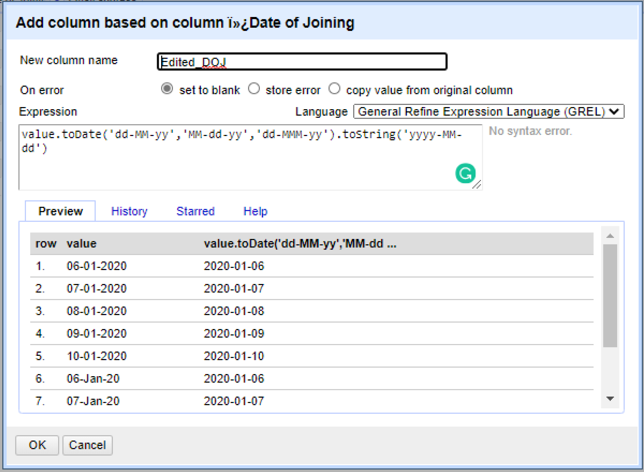
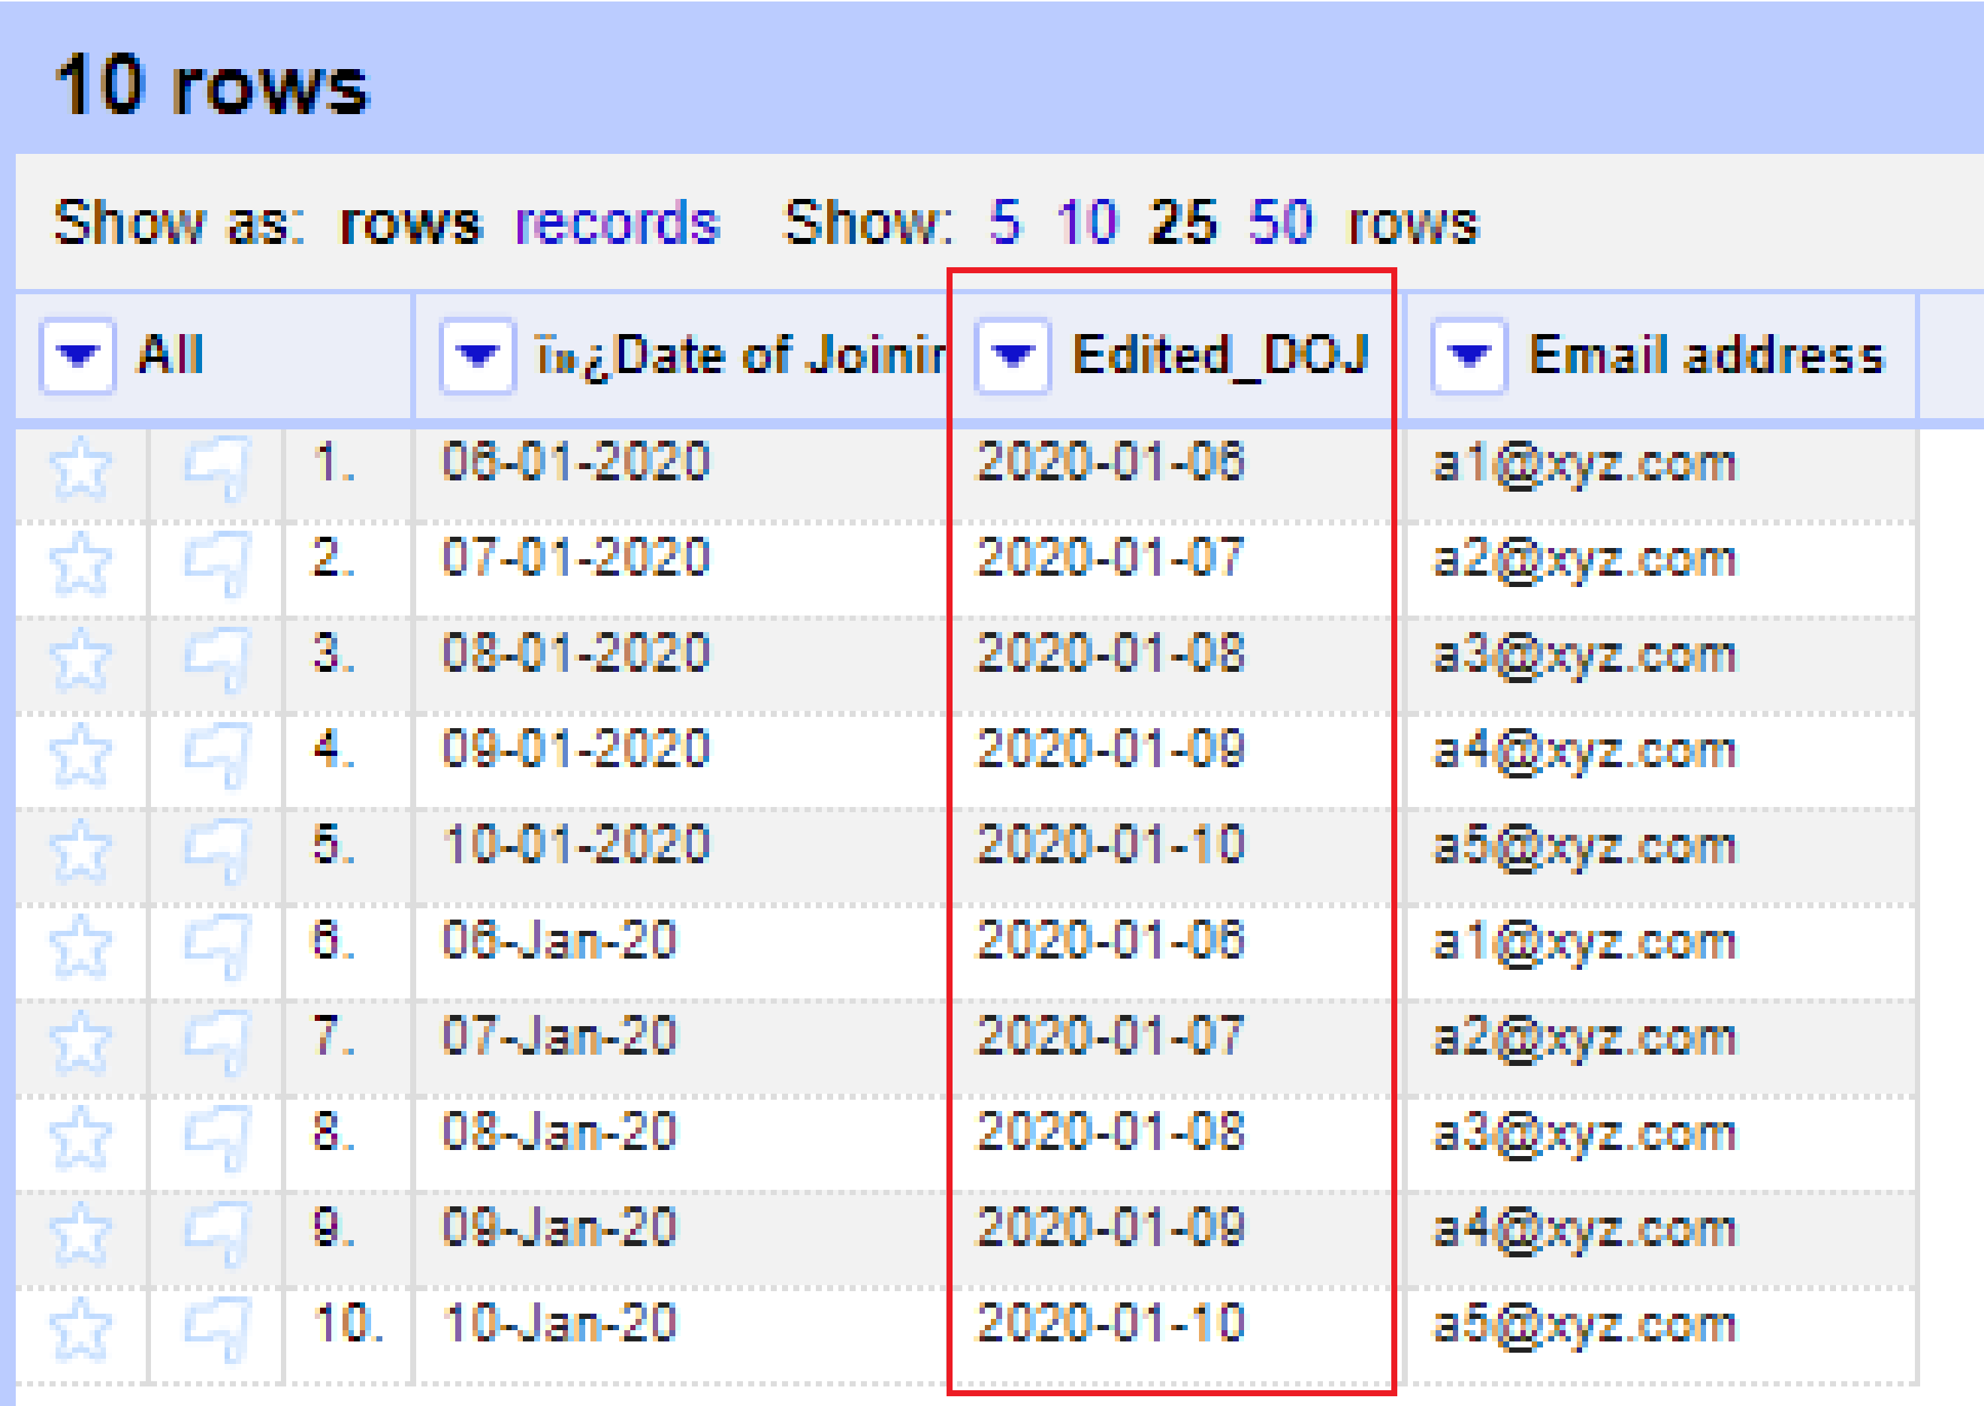
DATA CLEANING
Create a new column 'Edited_DOJ’ - continued
Create a new column 'Edited_DOJ' as follows:
1. Enter 'Edited_DOJ' for the New column name
2. Enter the following as the Expression and ensure the "Language is General Refine Expression Language"
value.toDate('dd-MM-yy','MM-dd-yy','dd-MMM-yy').toString('yyyy-MM-dd')
3. Click on the "OK" button.

Slide 15
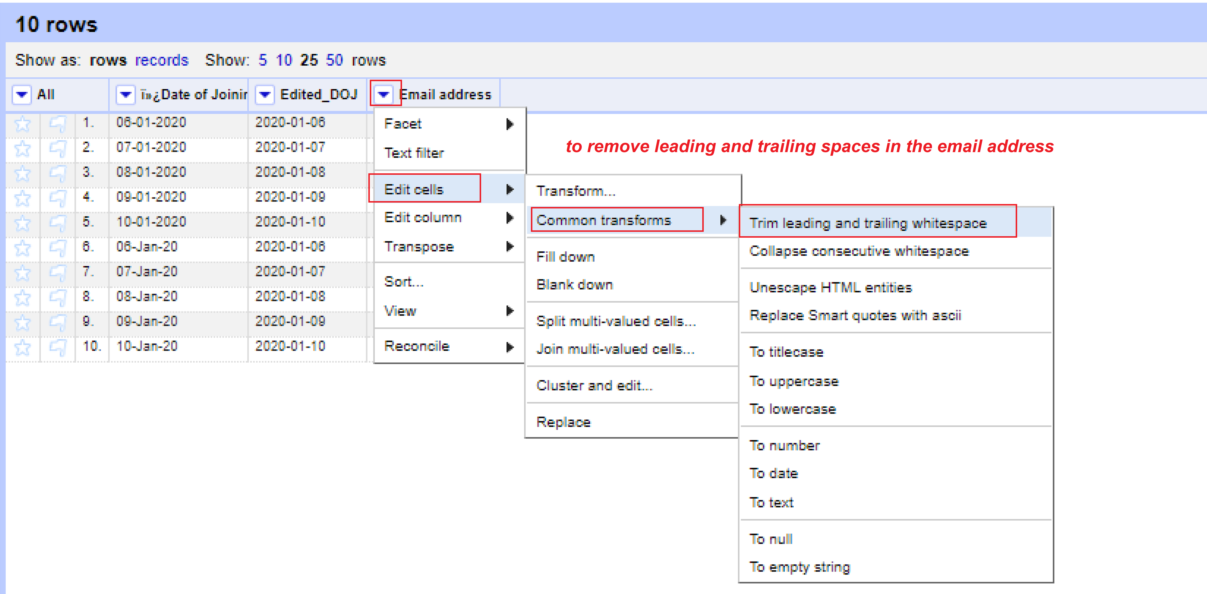
DATA CLEANING
How to remove leading and trailing spaces in the email address field?
1. Click on the LOV button near to the field, Email address.
2. Click on the menu item, Edit Cells >> Common transform >> Trim leading and trailing spaces
3. You can see the new data

Slide 16
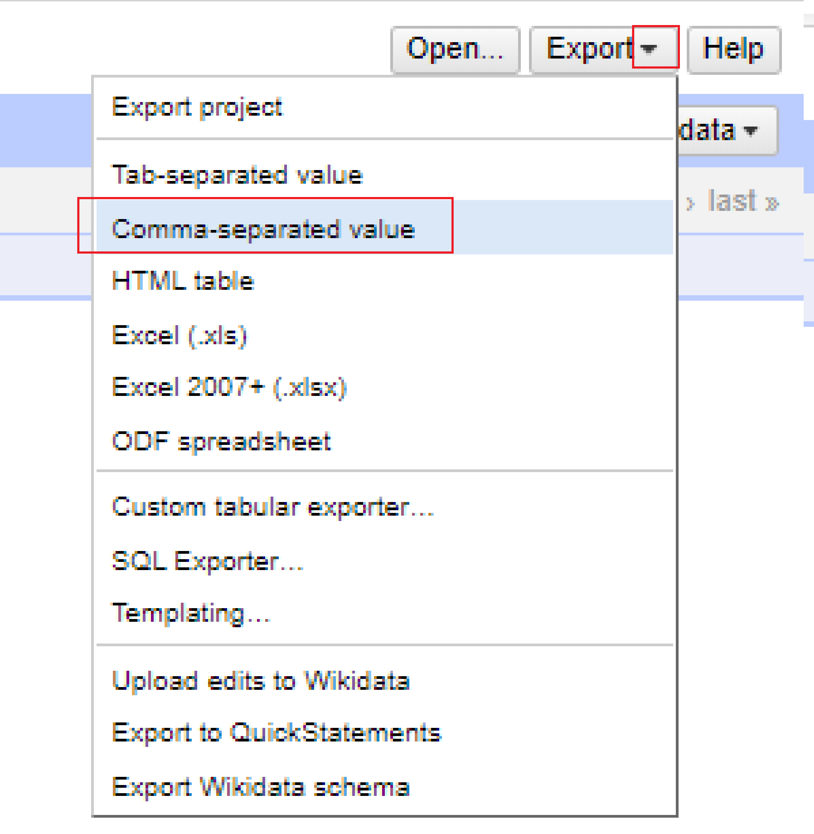
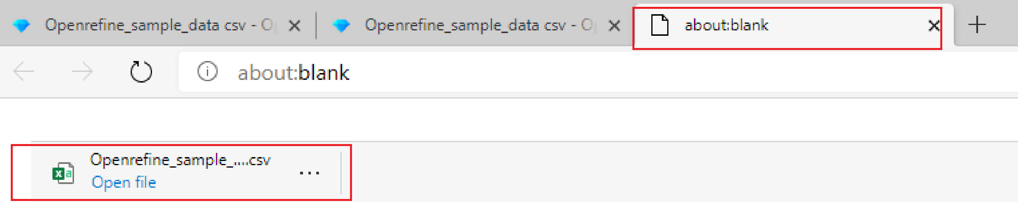
DATA CLEANING
How to export the data as CSV file?
1. Click on the LOV button near to Export button.
2. Click on the menu item, Comma-separated value
3. You can see a new .csv file created in a new window "about blank"

Slide 17


